Slide 1
Initial data exploration
AFO Field Validation
RFS Predictive Services, 20220401

Slide 2
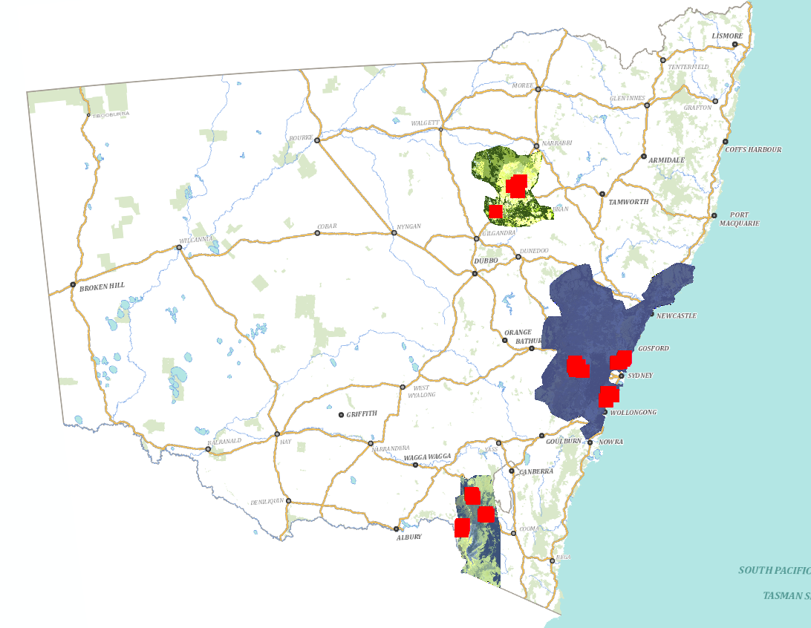
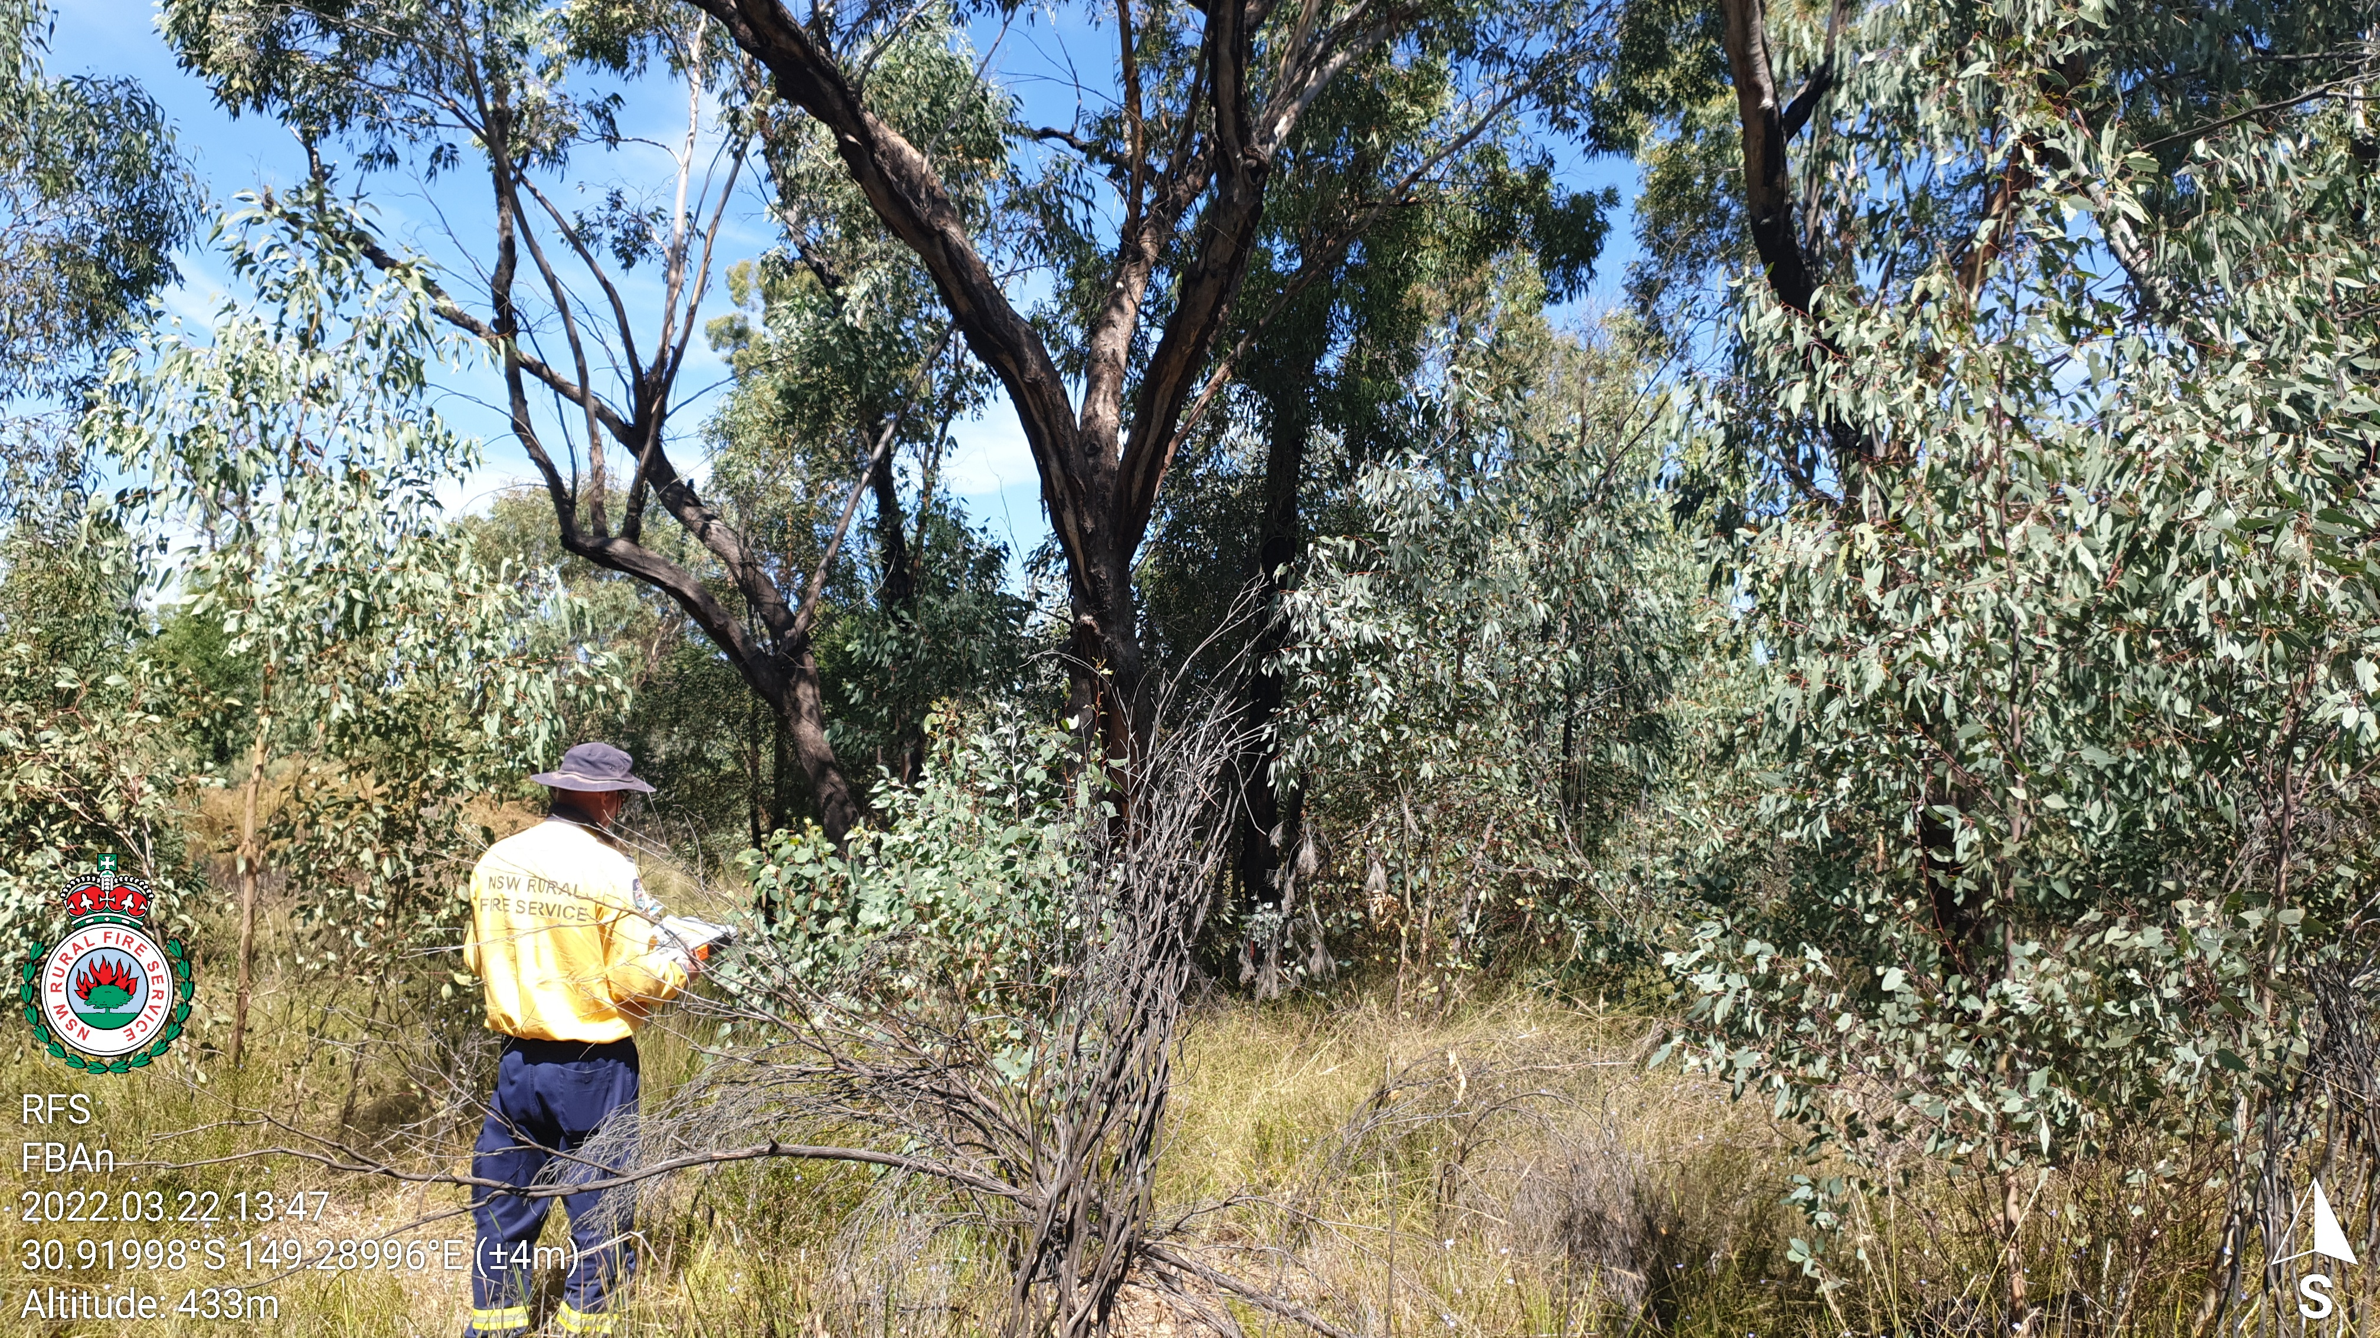
Field Sampling – 53 sites
3 x 20 m transects per site
By Area:
Central: 67
Pilliga: 31
Snowys: 61

Slide 3

Field Data – per 20 m transect
Litter depth: (mm) x 10
Litter cover: (presence/absence) x 10
Near surface fuel height: (m) x 10
Near surface fuel: (presence/absence) x 10
Elevated fuel height: (m) x 10
Elevated fuel: (presence/absence) x 10
Canopy height: (m) x 5
Canopy cover: (%) x 5
Bark type: x 1
Bark hazard rating: x 1
Photos: x heaps

Slide 4
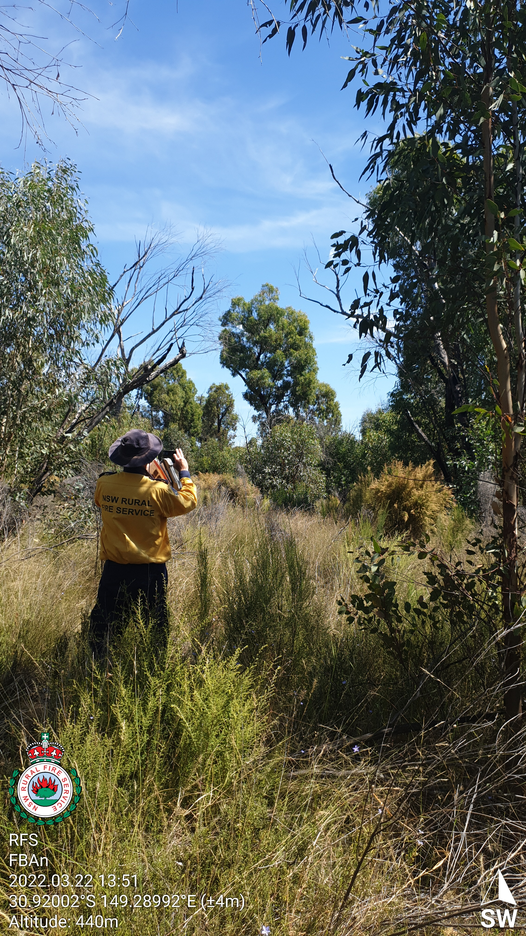
Field Data – averaged per plot
Litter depth: (mm) mean
Litter cover: %
Near surface fuel height: (m) mean
Near surface fuel: %
Elevated fuel height: (m) mean
Elevated fuel: %
Canopy height: (m) mean
Canopy cover: (%) mean
Bark type: x 1
Bark hazard rating: x 1
Photos: x heaps

Slide 5
Correlations (n = 159)
 | AFO
RFS Field | canopy cover % | ladder fuel density | canopy height (m) | canopy base height (m) | litter fuel (t/ha) | surface fuel (t/ha) | elevated fuel (t/ha) | bark fuel (t/ha)
litter depth (mm) | 0.31 | -0.19 | 0.49 | 0.23 | 0.49 | 0.51 | 0.37 | 0.65
litter cover (%) | 0.05 | -0.13 | 0.27 | 0.18 | 0.12 | 0.14 | 0.1 | 0.13
litter load (t/ha) | 0.23 | -0.13 | 0.41 | 0.19 | 0.41 | 0.42 | 0.3 | 0.55
near surface height (m) | -0.06 | 0.03 | -0.09 | -0.14 | 0.14 | 0.14 | 0.11 | 0.05
near suface cover (%) | -0.18 | 0.08 | 0.02 | 0.07 | 0.08 | 0.06 | -0.14 | -0.04
elevated fuel height (m) | 0.15 | 0.18 | 0.09 | -0.04 | 0.22 | 0.25 | 0.3 | 0.29
elev_cov | 0.11 | 0.23 | 0.06 | -0.07 | 0.13 | 0.16 | 0.21 | 0.23
elevated fuel load (t/ha) | 0.06 | 0.25 | 0 | -0.18 | 0 | 0.02 | 0.19 | 0.09
bark load (t/ha) | 0 | -0.04 | 0.4 | 0.17 | 0.07 | 0.07 | -0.04 | 0.2
canopy height (m) | -0.34 | -0.12 | 0.2 | 0.49 | -0.02 | -0.07 | -0.43 | -0.04
canopy cover (%) | 0.42 | -0.3 | 0.42 | 0.26 | 0.53 | 0.55 | 0.41 | 0.58

Slide 6
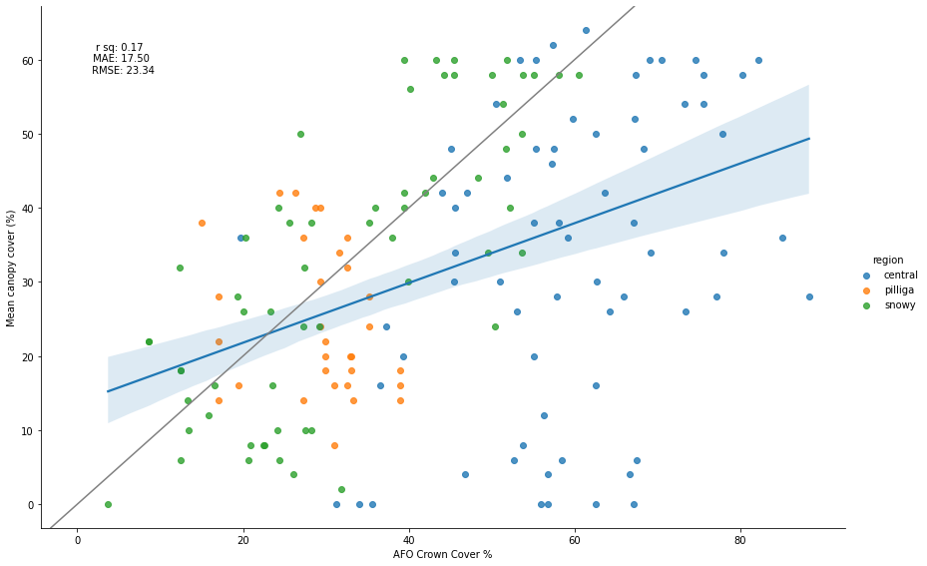
Canopy cover - all

Slide 7
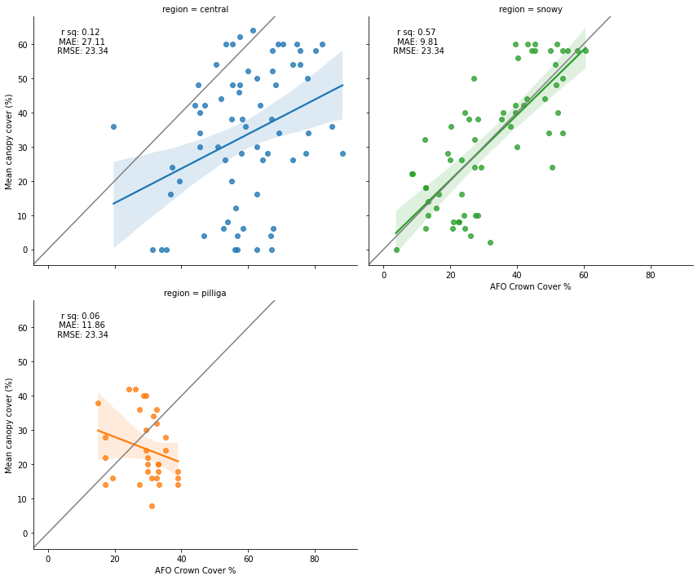
Canopy cover – by region

Slide 8
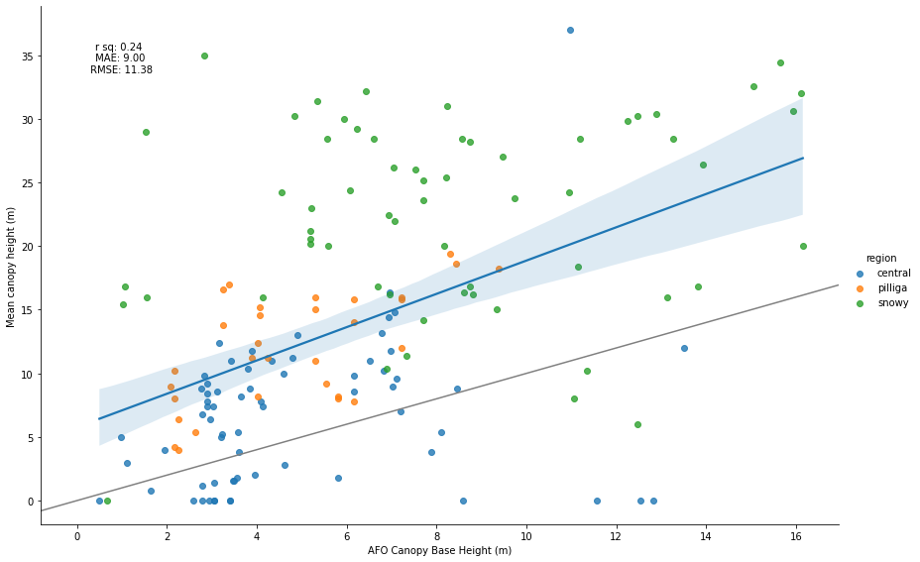
Canopy base height - all

Slide 9
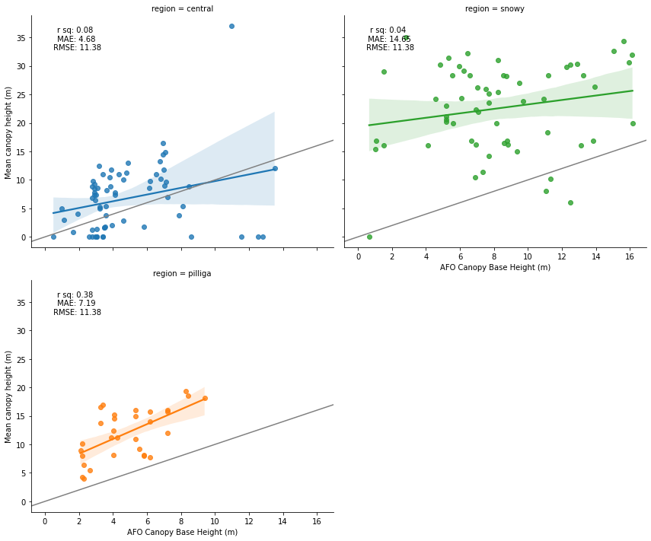
Canopy base height – by region

Slide 10
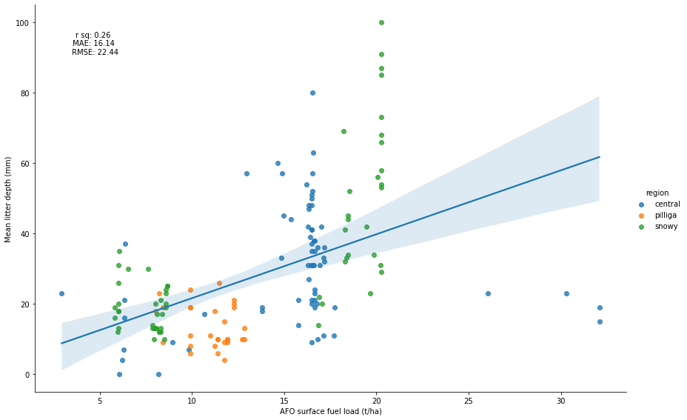
Surface fuel- all

Slide 11
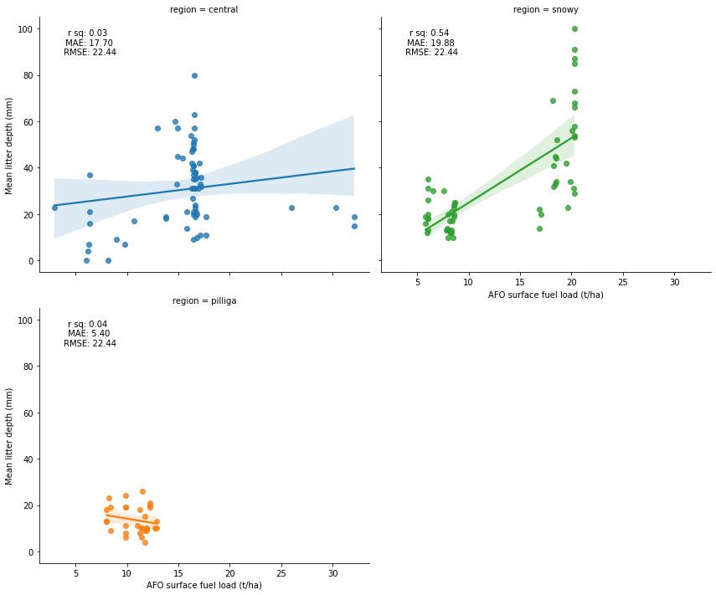
Surface fuel – by region

Slide 12
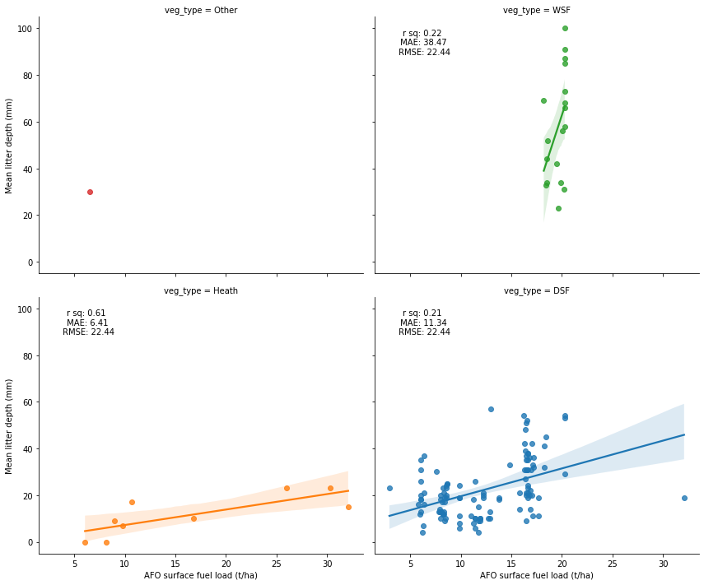
Surface fuel – by vegetation type

Slide 13
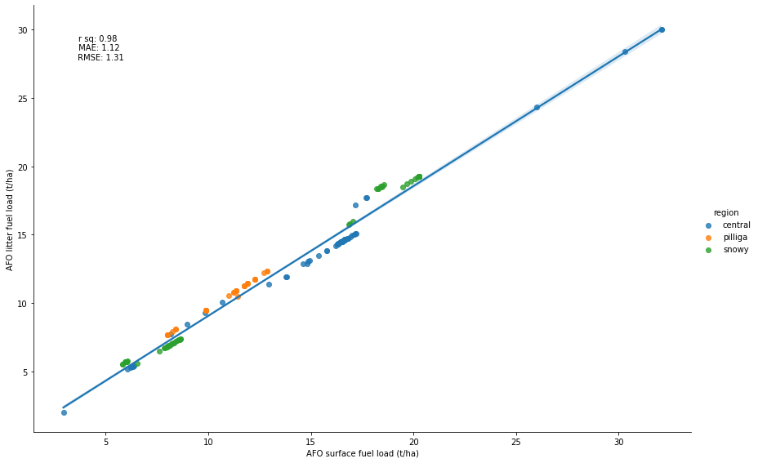
Issues
Cross-correlation

Slide 14
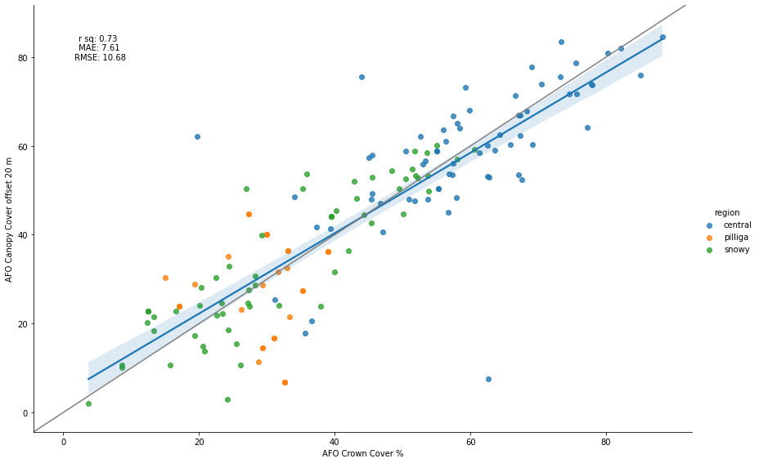
Issues
Spatial sensitivity

Slide 15
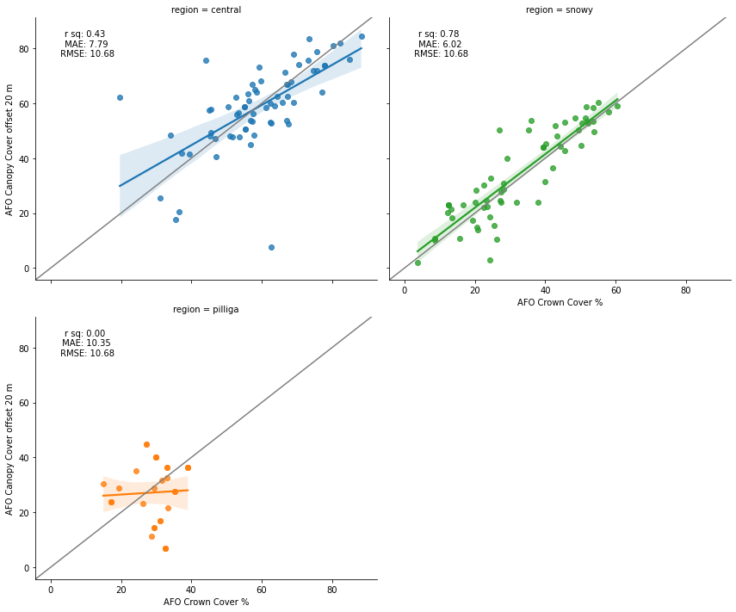
Issues
Spatial sensitivity

Slide 16
Correlation comparisons
 | AFO 10m grid n = 159 |  |  |  |  |  | AFO 30m grid n = 159
RFS Field | canopy cover % | canopy height (m) | canopy base height (m) | litter fuel (t/ha) | surface fuel (t/ha) | bark fuel (t/ha) | canopy cover % | canopy height (m) | canopy base height (m) | litter fuel (t/ha) | surface fuel (t/ha) | bark fuel (t/ha)
litter depth (mm) | 0.31 | 0.49 | 0.23 | 0.49 | 0.51 | 0.65 | 0.39 | 0.56 | 0.3 | 0.49 | 0.5 | 0.65
litter cover (%) | 0.05 | 0.27 | 0.18 | 0.12 | 0.14 | 0.13 | 0.08 | 0.29 | 0.2 | 0.12 | 0.14 | 0.14
litter load (t/ha) | 0.23 | 0.41 | 0.19 | 0.41 | 0.42 | 0.55 | 0.31 | 0.48 | 0.25 | 0.4 | 0.42 | 0.55
near surface height (m) | -0.06 | -0.09 | -0.14 | 0.14 | 0.14 | 0.05 | -0.07 | -0.06 | -0.11 | 0.15 | 0.15 | 0.05
near suface cover (%) | -0.18 | 0.02 | 0.07 | 0.08 | 0.06 | -0.04 | -0.15 | 0.05 | 0.1 | 0.08 | 0.06 | -0.04
elevated fuel height (m) | 0.15 | 0.09 | -0.04 | 0.22 | 0.25 | 0.29 | 0.16 | 0.09 | -0.04 | 0.23 | 0.25 | 0.28
elev_cov | 0.11 | 0.06 | -0.07 | 0.13 | 0.16 | 0.23 | 0.12 | 0.08 | -0.07 | 0.14 | 0.16 | 0.22
elevated fuel load (t/ha) | 0.06 | 0 | -0.18 | 0 | 0.02 | 0.09 | 0.07 | -0.04 | -0.23 | 0.01 | 0.03 | 0.09
bark load (t/ha) | 0 | 0.4 | 0.17 | 0.07 | 0.07 | 0.2 | 0 | 0.42 | 0.19 | 0.06 | 0.06 | 0.2
canopy height (m) | -0.34 | 0.2 | 0.49 | -0.02 | -0.07 | -0.04 | -0.28 | 0.24 | 0.53 | -0.02 | -0.07 | -0.03
canopy cover (%) | 0.42 | 0.42 | 0.26 | 0.53 | 0.55 | 0.58 | 0.51 | 0.46 | 0.29 | 0.53 | 0.54 | 0.59

Slide 17
Correlation comparisons
 | AFO (n = 159) |  |  |  |  |  | AFO mean of sites (n = 53)
RFS Field | canopy cover % | canopy height (m) | canopy base height (m) | litter fuel (t/ha) | surface fuel (t/ha) | bark fuel (t/ha) | canopy cover % | canopy height (m) | canopy base height (m) | litter fuel (t/ha) | surface fuel (t/ha) | bark fuel (t/ha)
litter depth (mm) | 0.31 | 0.49 | 0.23 | 0.49 | 0.51 | 0.65 | 0.38 | 0.55 | 0.26 | 0.52 | 0.54 | 0.71
litter cover (%) | 0.05 | 0.27 | 0.18 | 0.12 | 0.14 | 0.13 | 0 | 0.34 | 0.21 | 0.16 | 0.19 | 0.09
litter load (t/ha) | 0.23 | 0.41 | 0.19 | 0.41 | 0.42 | 0.55 | 0.31 | 0.45 | 0.21 | 0.47 | 0.49 | 0.64
near surface height (m) | -0.06 | -0.09 | -0.14 | 0.14 | 0.14 | 0.05 | 0.02 | -0.02 | -0.11 | 0.19 | 0.19 | 0.09
near suface cover (%) | -0.18 | 0.02 | 0.07 | 0.08 | 0.06 | -0.04 | -0.18 | 0.04 | 0.15 | 0.09 | 0.07 | -0.05
elevated fuel height (m) | 0.15 | 0.09 | -0.04 | 0.22 | 0.25 | 0.29 | 0.25 | 0.1 | -0.1 | 0.24 | 0.27 | 0.35
elev_cov | 0.11 | 0.06 | -0.07 | 0.13 | 0.16 | 0.23 | 0.19 | 0.09 | -0.08 | 0.12 | 0.16 | 0.3
elevated fuel load (t/ha) | 0.06 | 0 | -0.18 | 0 | 0.02 | 0.09 | 0.22 | 0.1 | -0.19 | 0.03 | 0.07 | 0.2
bark load (t/ha) | 0 | 0.4 | 0.17 | 0.07 | 0.07 | 0.2 | -0.03 | 0.46 | 0.15 | 0.08 | 0.07 | 0.2
canopy height (m) | -0.34 | 0.2 | 0.49 | -0.02 | -0.07 | -0.04 | -0.42 | 0.25 | 0.62 | -0.05 | -0.11 | -0.04
canopy cover (%) | 0.42 | 0.42 | 0.26 | 0.53 | 0.55 | 0.58 | 0.43 | 0.33 | 0.16 | 0.54 | 0.55 | 0.55

